Slide 1
ARTISTRY OF ALS
2025

Slide 2
ARTISTRY OF ALS
See interviews with the artists at www.iamals.org/artistry-of-als-2025/

Slide 3
AMY MCKNIGHT
Amy loves to work with watercolors; her images have an intensely organic quality to them.
www.iamals.org/artistry-of-als-2025/

Slide 4
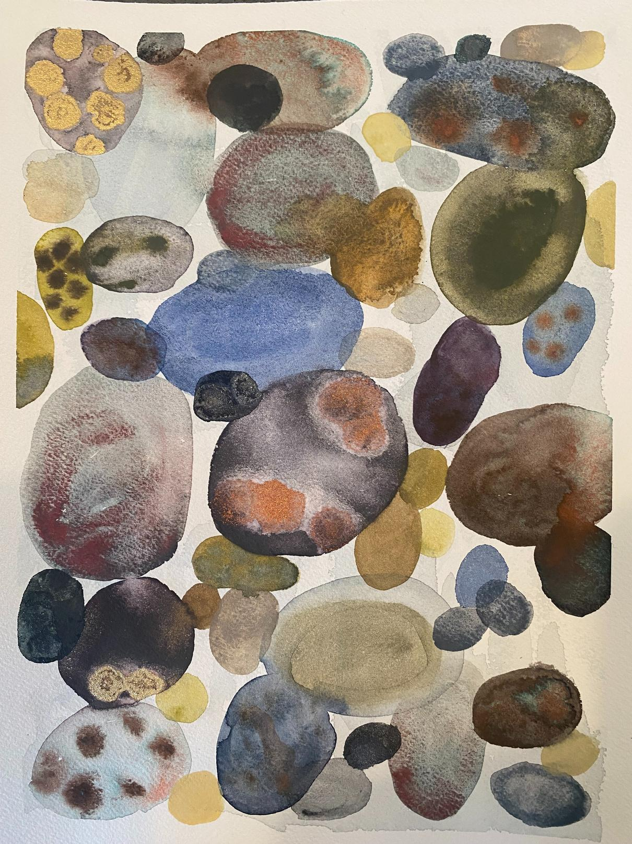
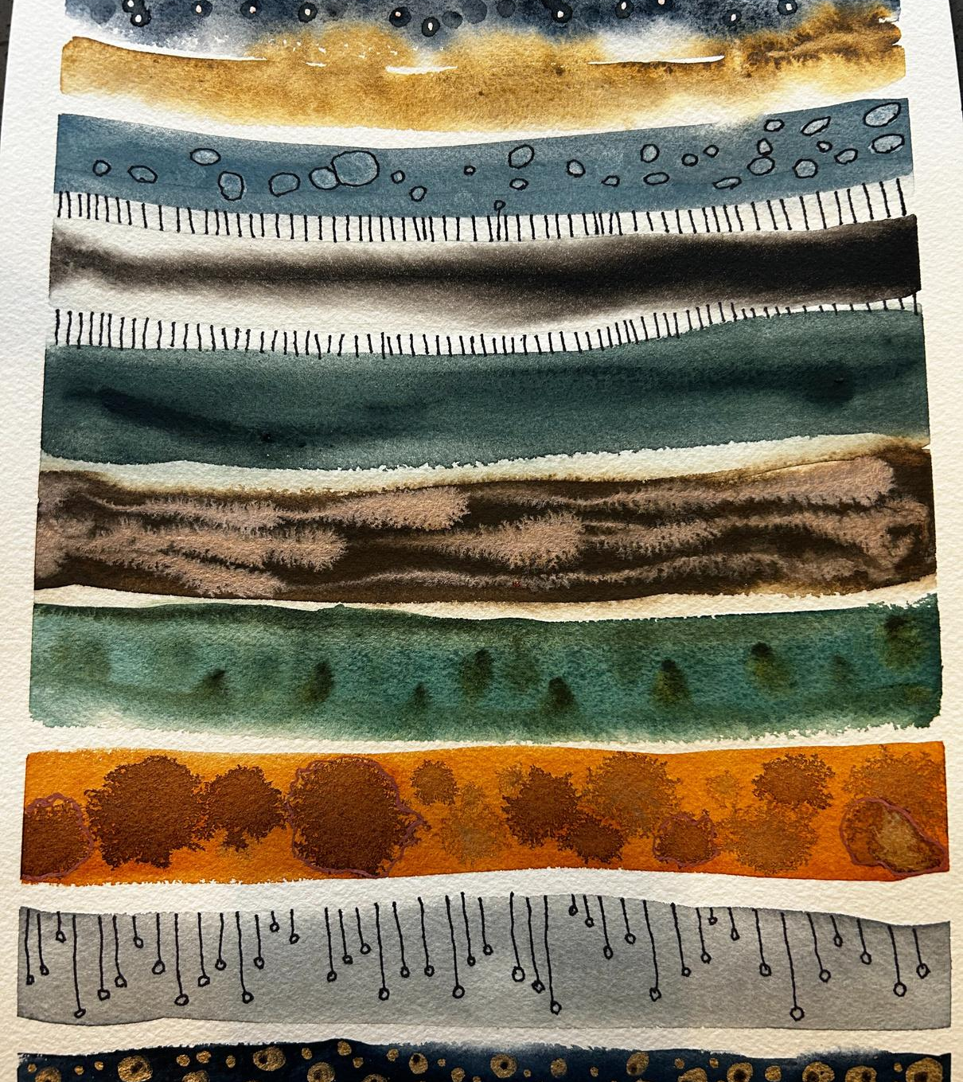
www.iamals.org/artistry-of-als-2025/

Slide 5
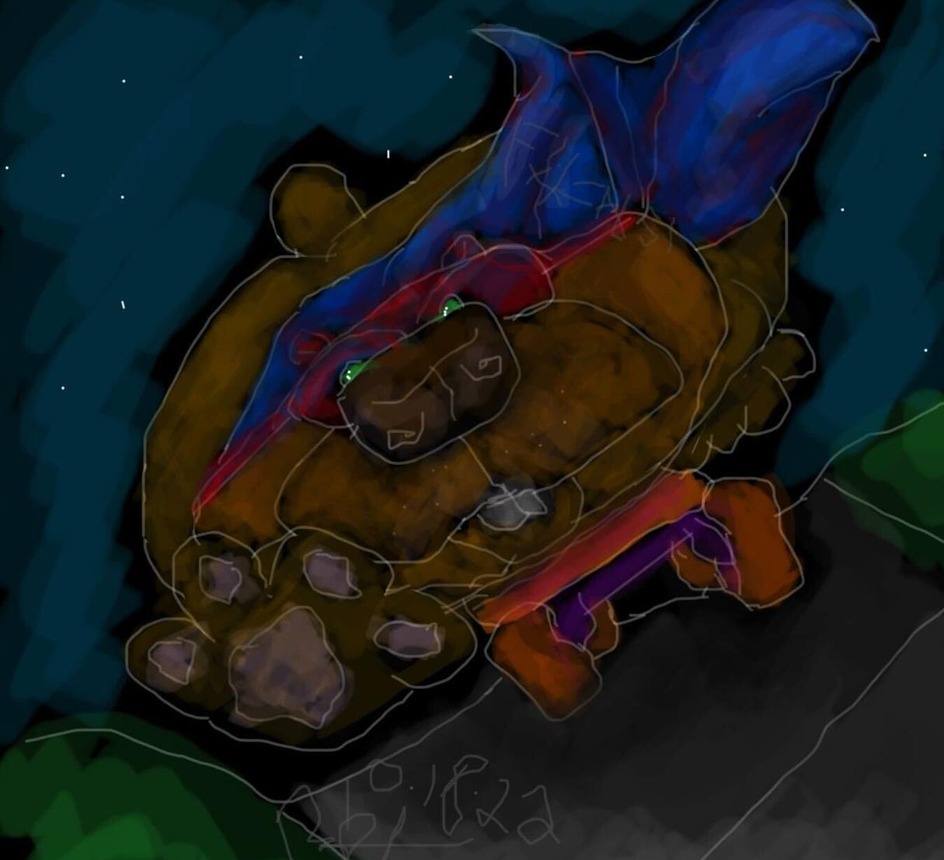
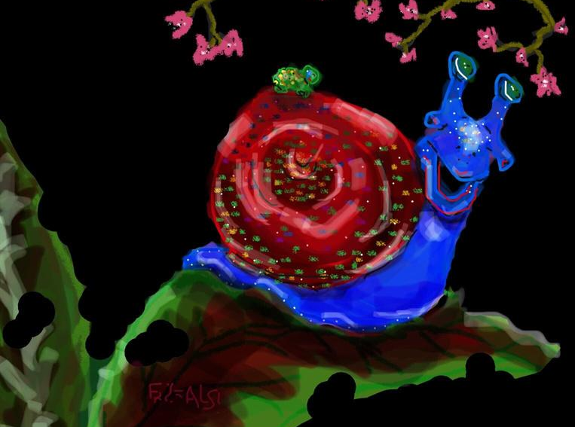
www.iamals.org/artistry-of-als-2025/
BRANDY TRIGONA
This is Brandy’s third year participating in the Artistry of ALS. Her spirit and compassion for others shines through in her work.

Slide 6
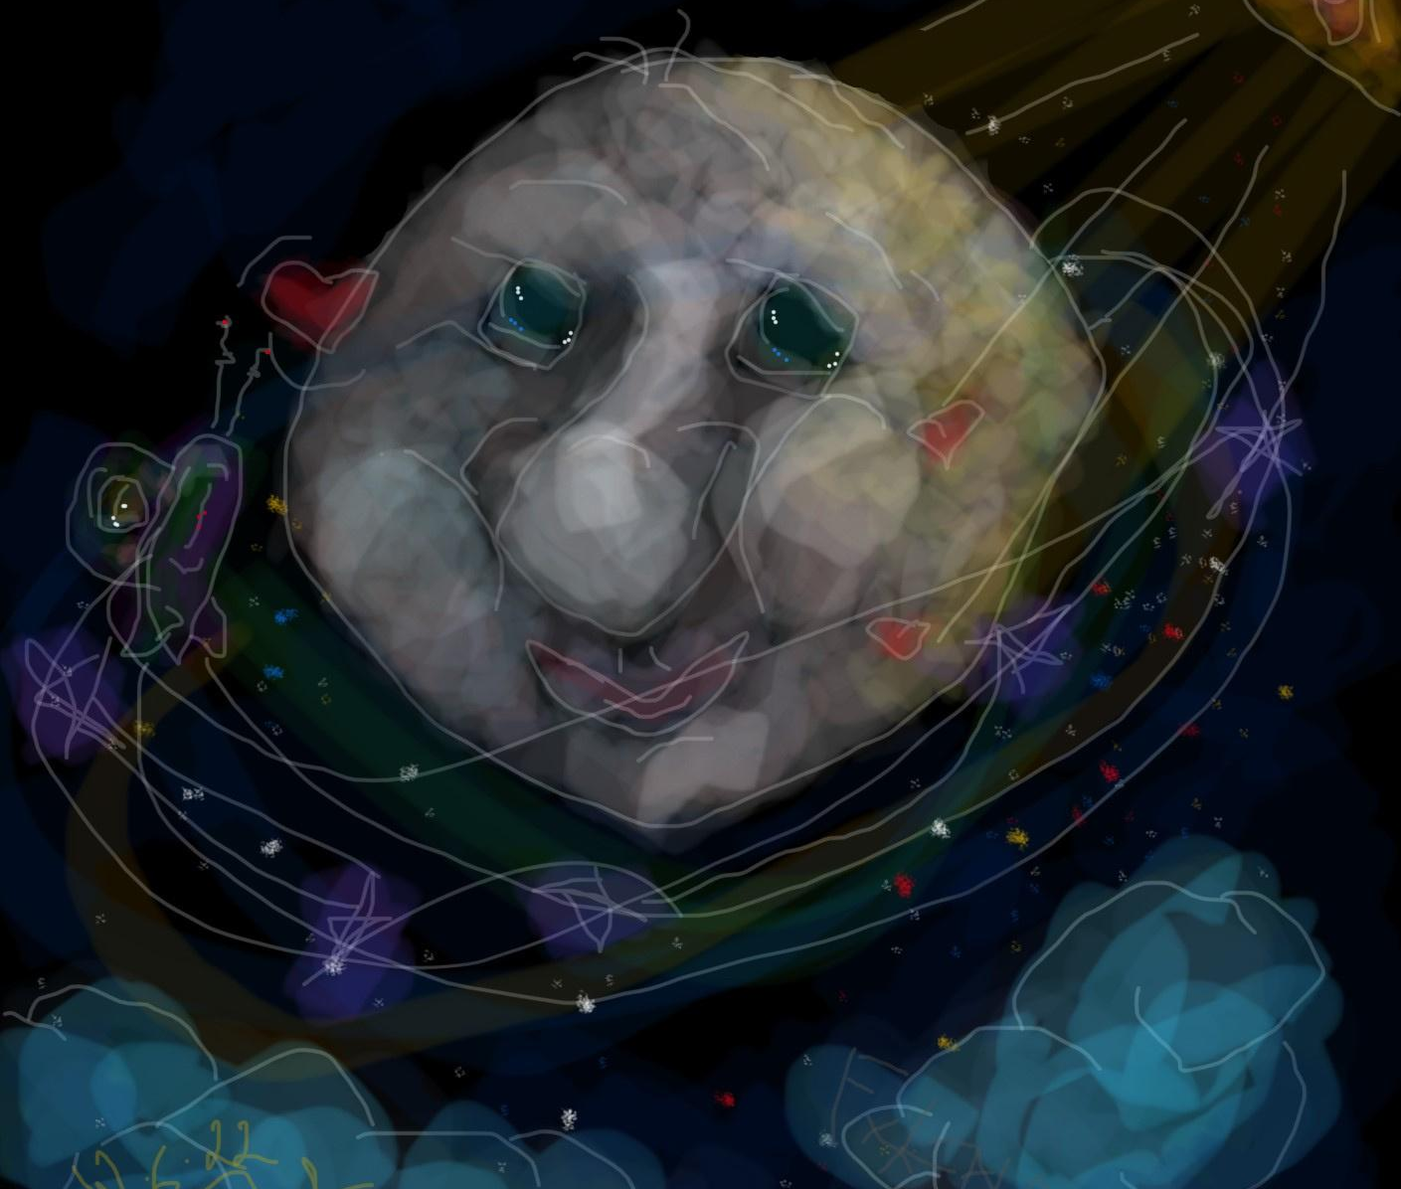
Being an advocate for the underdog is where I will always raise a voice. No matter if it's in the workplace, or the schoolyard. There isn't anyone I won't reach back to help forward.
Love, compassion, empathy, all play a role in this world, no matter your station.
www.iamals.org/artistry-of-als-2025/

Slide 7
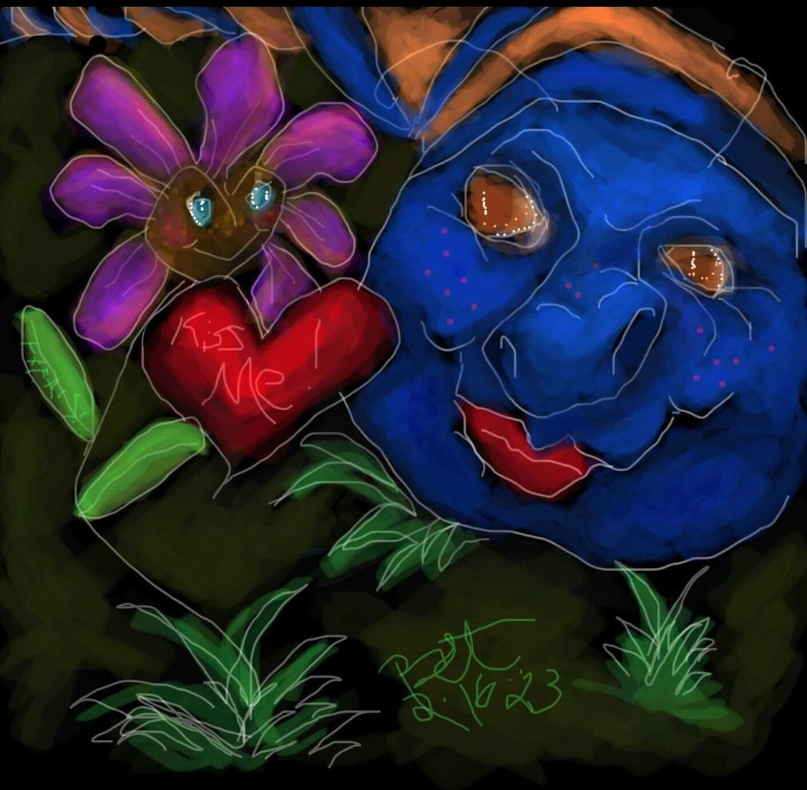
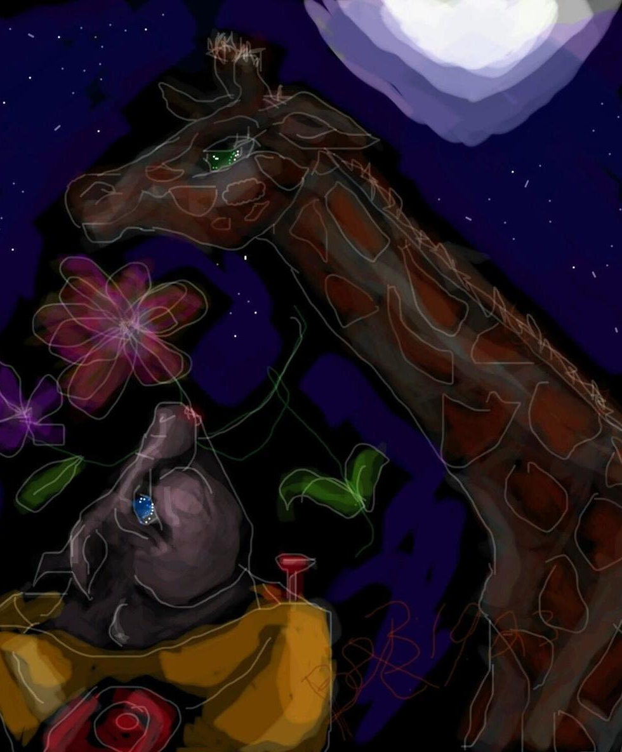
www.iamals.org/artistry-of-als-2025/

Slide 8
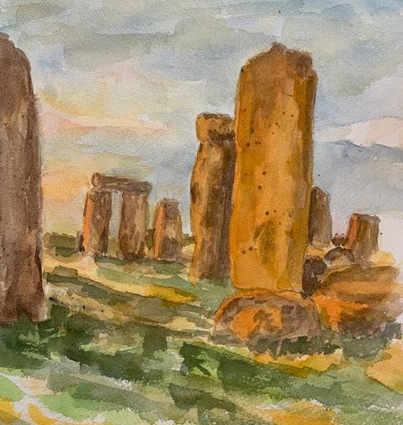
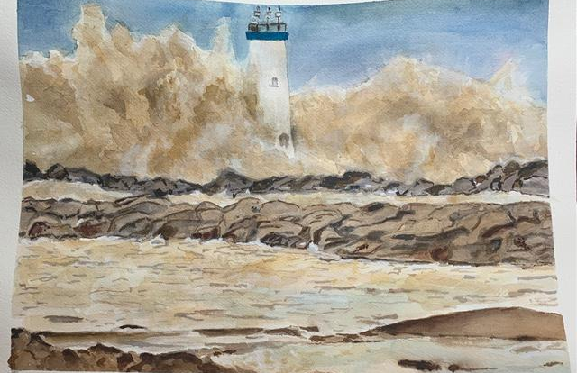
www.iamals.org/artistry-of-als-2025/
CAROLE THOMAS
Painter
Healer
Home

Slide 9
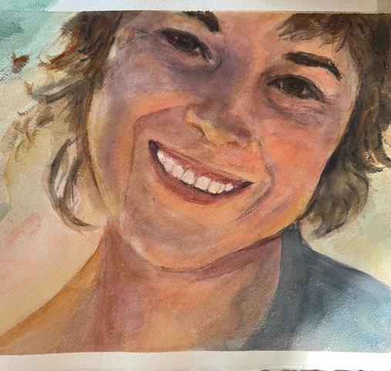
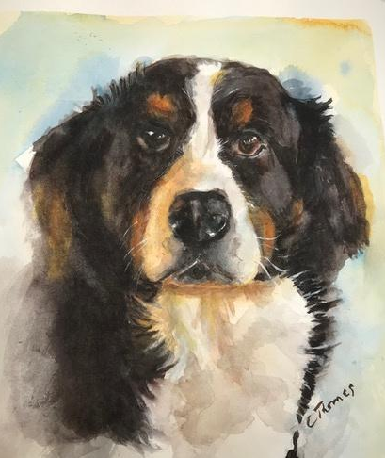
www.iamals.org/artistry-of-als-2025/

Slide 10
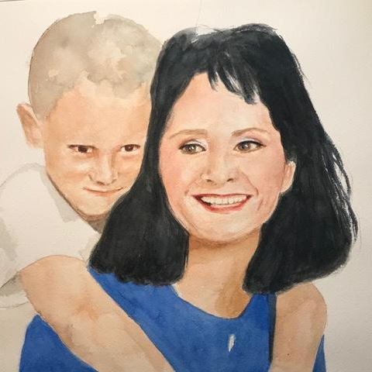
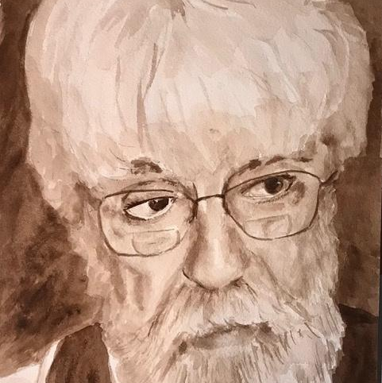
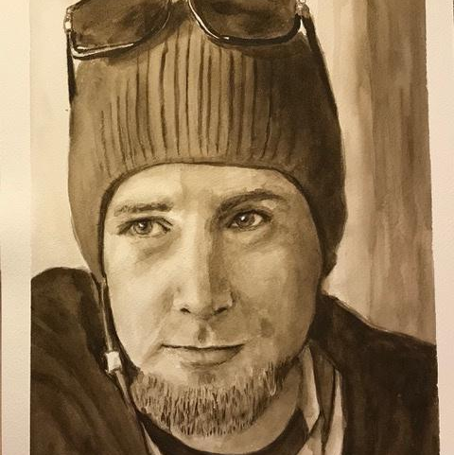
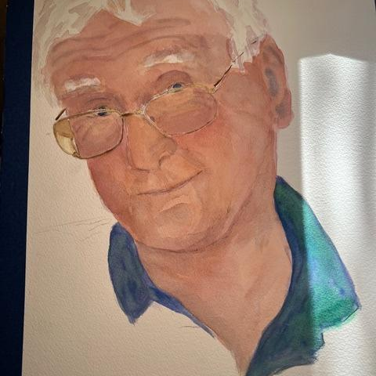
www.iamals.org/artistry-of-als-2025/
Carole is certified Bodytalker, third-level Reiki, third-level Sourcepoint, and fourth-level Healing Touch energy worker. Her formal study of energy work and the expansion of her artwork both have provided purpose, peace and healing on her ALS journey. Some of Carole’s favorite pieces are of family, friends, and pets.

Slide 11
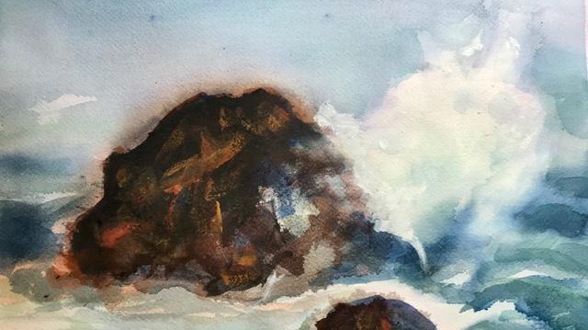
www.iamals.org/artistry-of-als-2025/

Slide 12
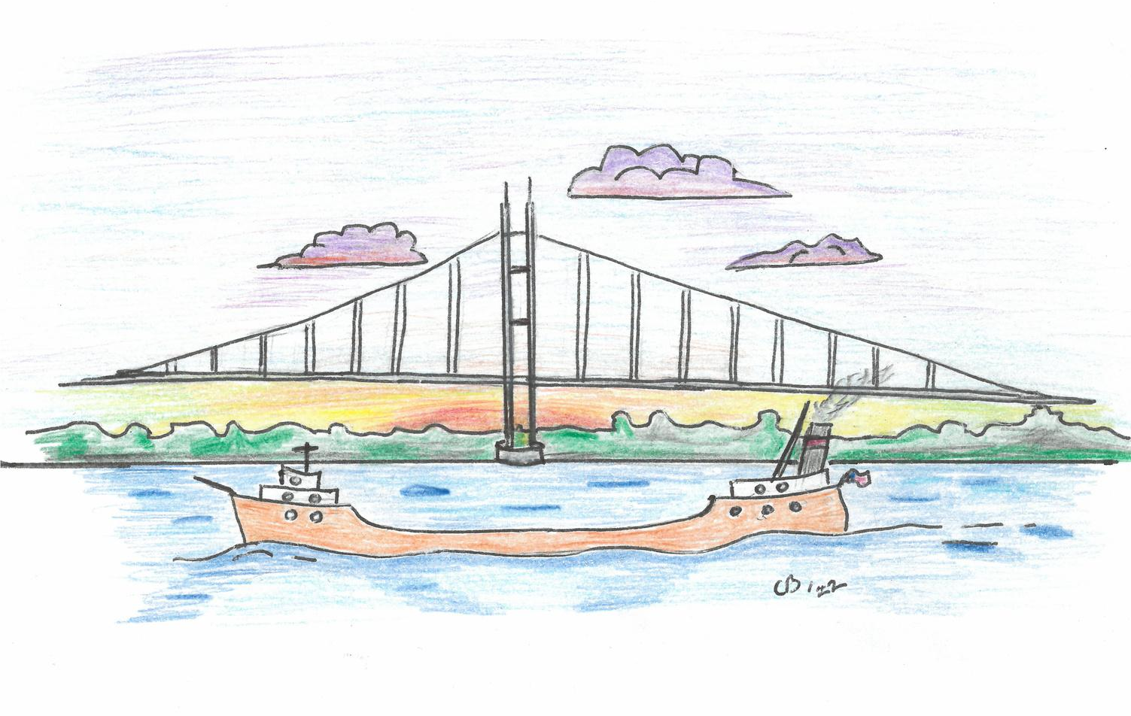
CHRISTOPHER JON BERKEY
www.iamals.org/artistry-of-als-2025/
Chris Berkey is a retired freighter captain who sailed the Great Lakes. These pieces were the inspiration for a pin he hands out to people in the ALS community who have been a help to his family. The boat represents those Chris worked on for 22 years before ALS forced him to retire. The bridge is the Mackinac Bridge, which connects the lower and upper peninsulas of Michigan. The words "Float Hope" represent the way they are approaching life after ALS.

Slide 13
www.iamals.org/artistry-of-als-2025/

Slide 14
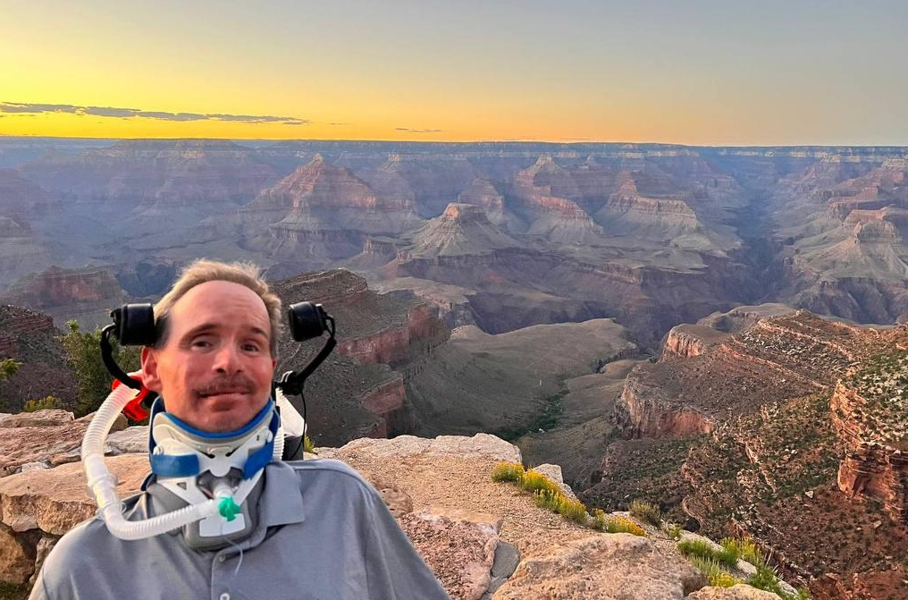
www.iamals.org/artistry-of-als-2025/
CHRISTOPHER CORLEONE
An author of five books since his diagnosis with ALS, Christopher has turned to writing as a way of managing the dragon. A dedicated Philadelphia Eagles fan, his artistry is in his words, and he shares with us a letter he wrote for his family.

Slide 15
THE GHOST
www.iamals.org/artistry-of-als-2025/
Even though I am alive, I often feel like a ghost in my own home. The familiar walls that once echoed with laughter now hold the weight of silence. Memories dance in every room like shadows, reminding me of the joy that once filled these spaces. Yet, as I navigate through my days, I find myself drifting, unable to fully engage with the life around me.

Slide 16
THE GHOST
www.iamals.org/artistry-of-als-2025/
The warmth of love, once a comforting embrace, has turned to a chilling distance. Time, with its relentless passage, has woven a heavy thread that separates me from those I cherish. I reach out, but the connection feels fragile, as if I am grasping at smoke. What once was vibrant now feels hollow and empty, and I am left to wander through memories in my head of what it was that seems like a lifetime ago.

Slide 17
THE GHOST
www.iamals.org/artistry-of-als-2025/
ALS has made me a stranger to those I love. Despite my physical presence, I often feel invisible, a mere observer of their lives and everything around me. I watch their smiles of happiness from a distance, feeling the strain of my own separation when they pass by without a word. Each laugh I hear is a reminder of the connection I once had, yet cannot fully grasp as it slowly slips away. I am caught between the desire to engage and the fear of continued alienation. Like I am part of two separate worlds but neither has meaning or purpose.

Slide 18
THE GHOST
www.iamals.org/artistry-of-als-2025/
Ultimately, I find that living in this state is a special kind of survival. But I often ask myself, would it be different if I were really a ghost, a distant memory? I may be physically present, but emotionally, I drift away, lost in the echoes of what used to be before the tragedy. My home, that is filled with memories, becomes a bittersweet reminder of a life where I truly felt alive. Yet, even though I am alive, I find myself tormented from being a real ghost or wanting the warmth of connection that always seems just out of reach.
Signed,
The Ghost

Slide 19
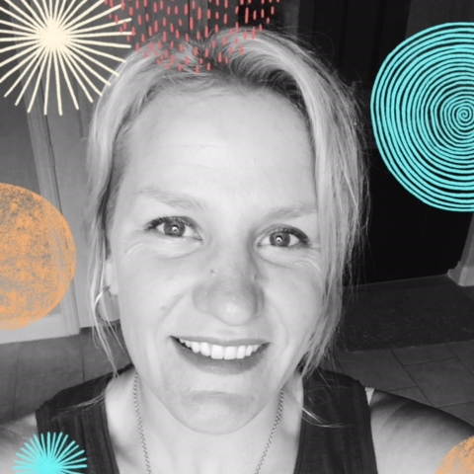
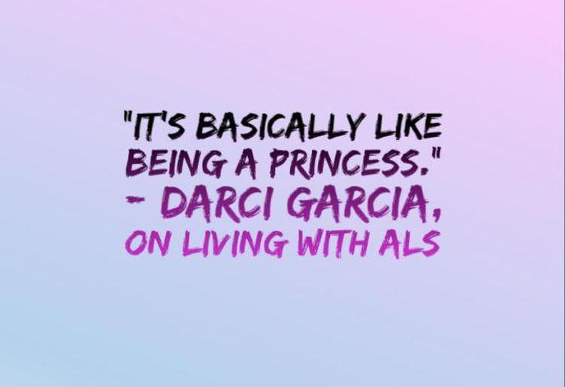
www.iamals.org/artistry-of-als-2025/
DARCI GARCIA
Diagnosed in 2018, Darci Garcia is an ALS warrior focused on her faith, family and community. You can find her on Facebook at “Darci’s Defenders”, her personal blog.

Slide 20
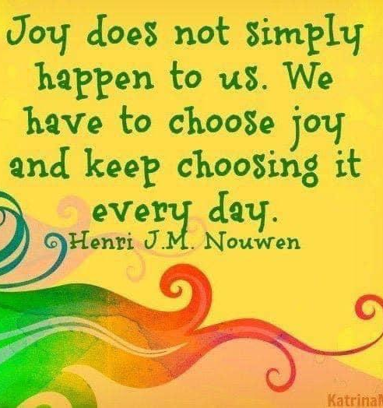
www.iamals.org/artistry-of-als-2025/

Slide 21
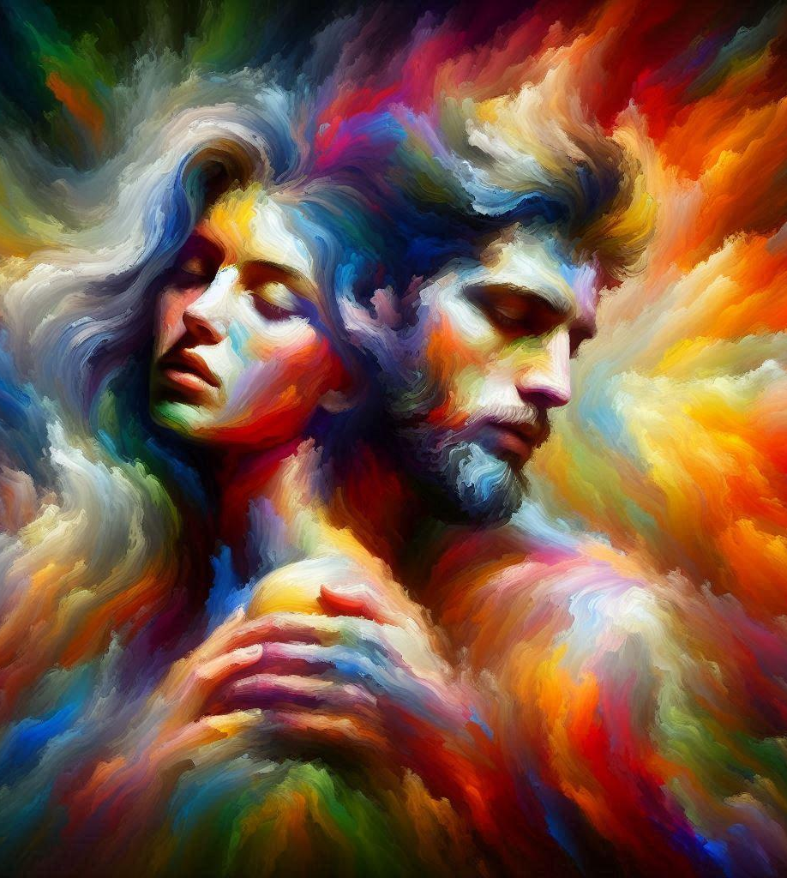
JUAN ESCALERA
www.iamals.org/artistry-of-als-2025/

Slide 22
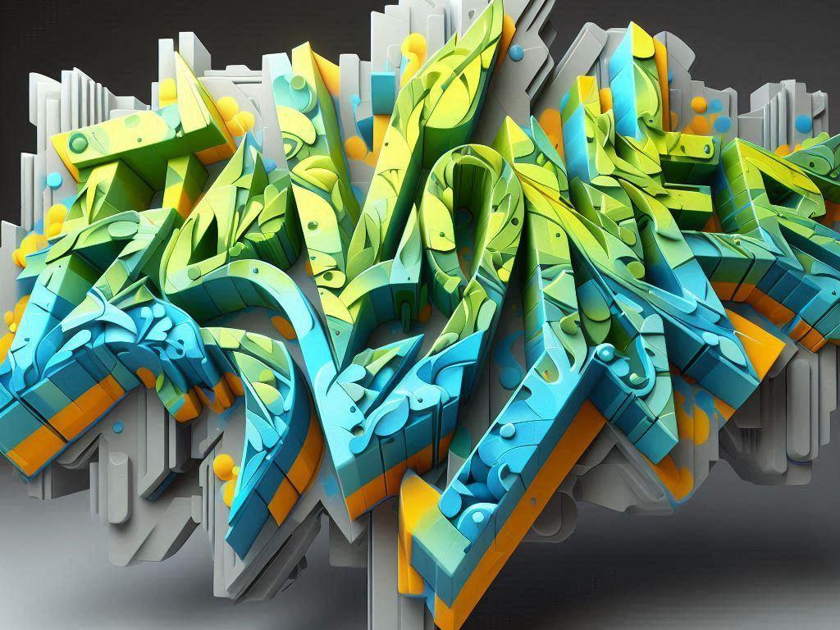
www.iamals.org/artistry-of-als-2025/
Juan Escalera is a Chiaroscuro artist with a passion for painting landscapes and many other things. His high school graffiti tag name was “Flavoner”, represented in the image to the left. When ALS took away the use of his hands, he never thought he would be able to create art again.
Juan is the 2025 recipient of the I Am ALS Scott Davis Amplify Awareness award.

Slide 23
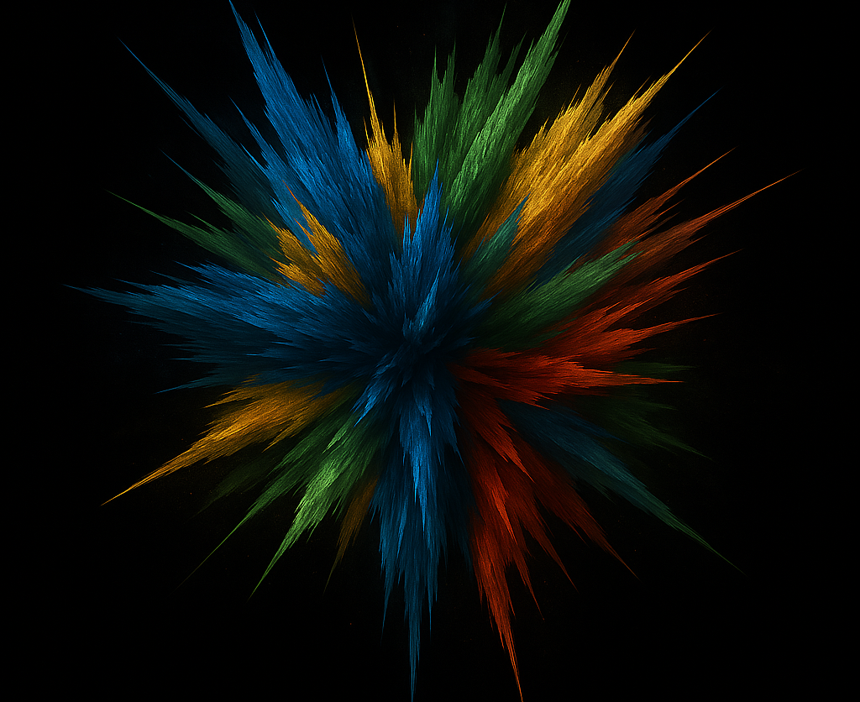
www.iamals.org/artistry-of-als-2025/

Slide 24
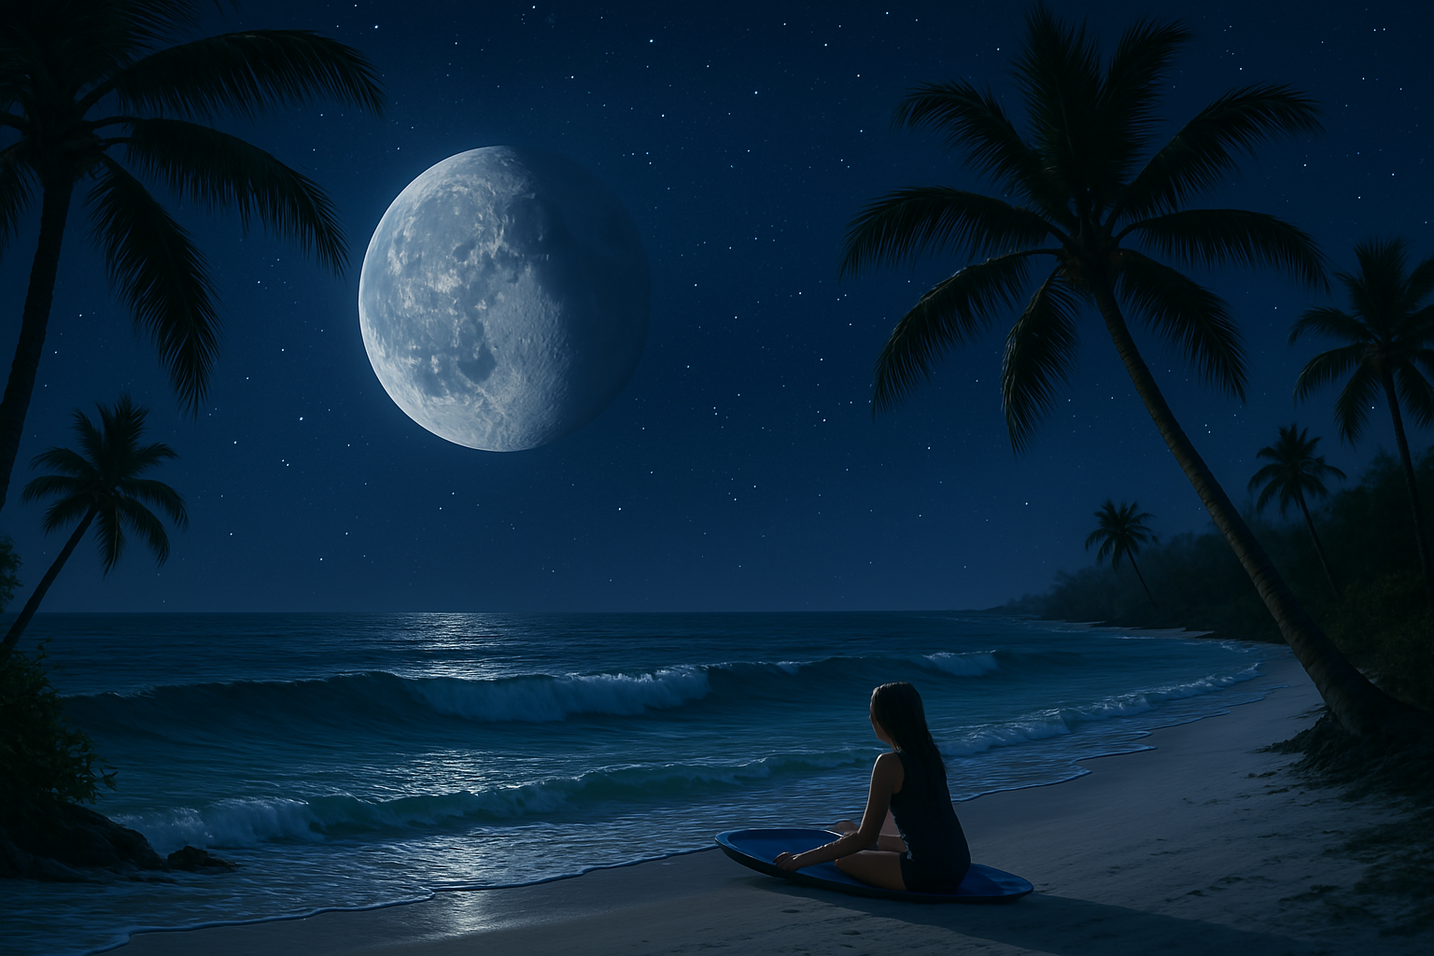
www.iamals.org/artistry-of-als-2025/

Slide 25
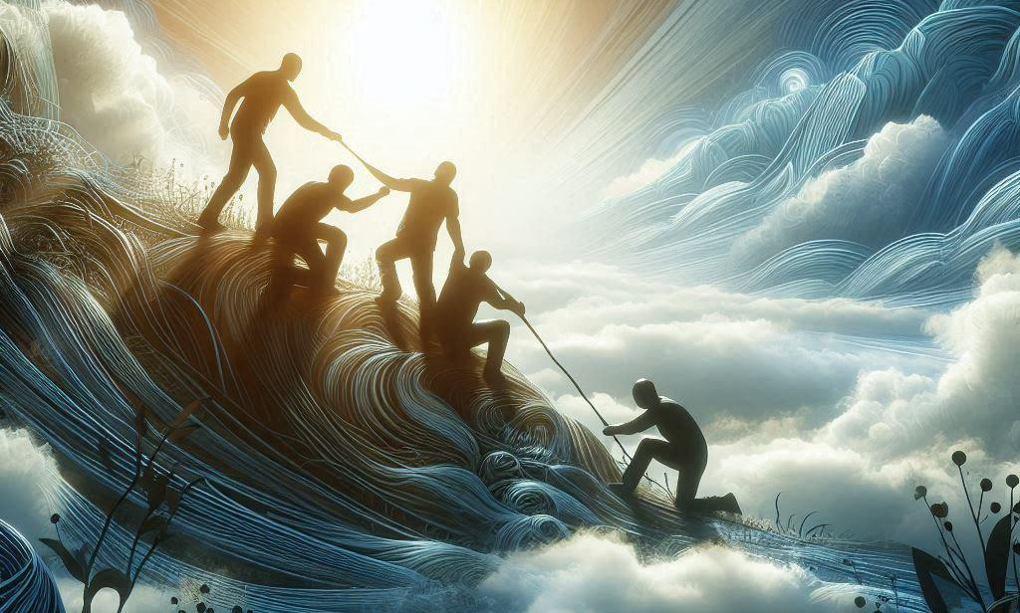
www.iamals.org/artistry-of-als-2025/

Slide 26
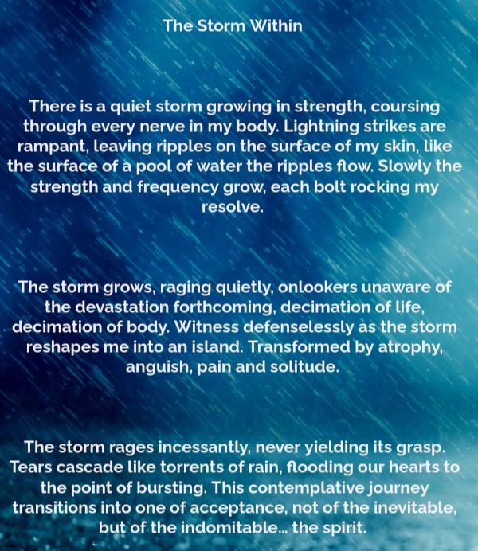
JUAN REYES
Juan Reyes, known affectionately in the ALS community as “the JUAN and ONLY,” has been writing and creating prolifically since his diagnosis. He is famous for whipping up inspiration on the fly, spring boarding from idea to concept to full realized project in a very short period of time. His catch phrase is, “Sure we can.”
Indeed, we can.
www.iamals.org/artistry-of-als-2025/

Slide 27
www.iamals.org/artistry-of-als-2025/

Slide 28
www.iamals.org/artistry-of-als-2025/

Slide 29
www.iamals.org/artistry-of-als-2025/

Slide 30
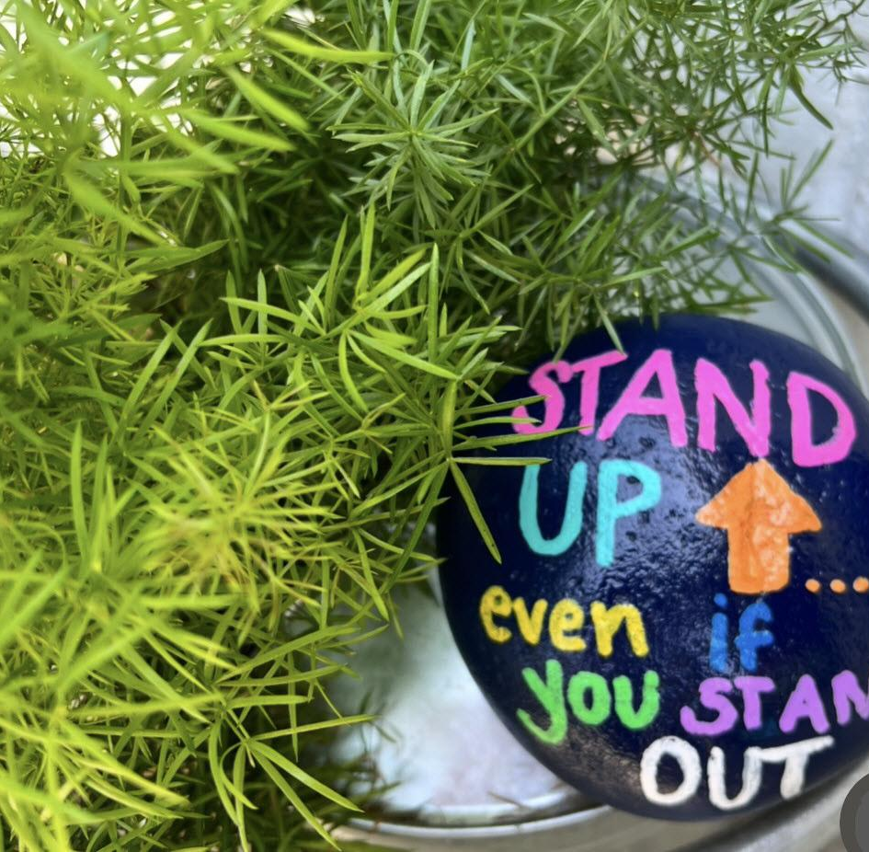
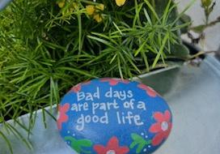
www.iamals.org/artistry-of-als-2025/
KATIE SCHOPP
Fearless
Nurturing
Advocate

Slide 31
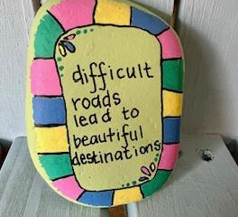
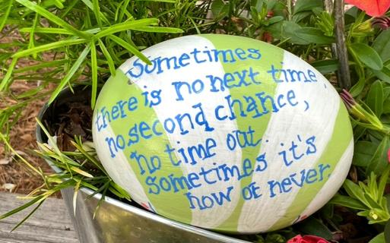
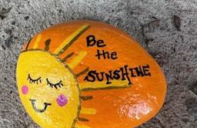
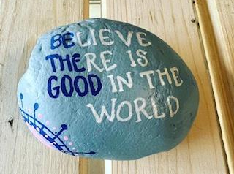
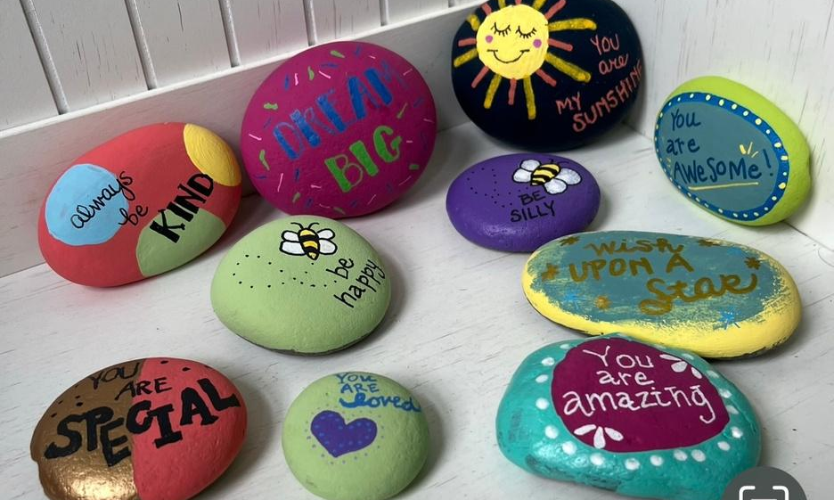
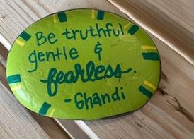
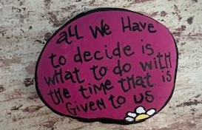
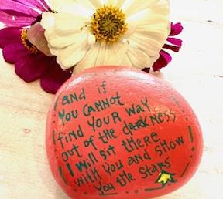
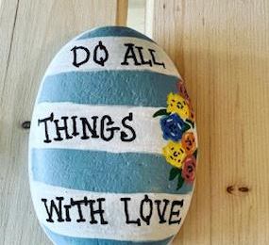
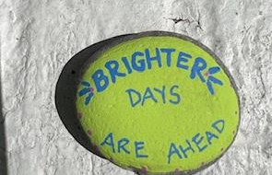
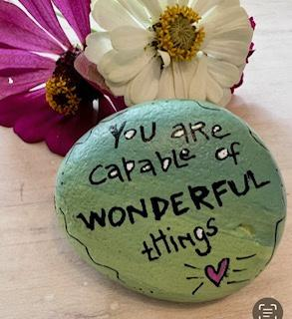
www.iamals.org/artistry-of-als-2025/

Slide 32
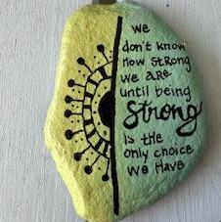
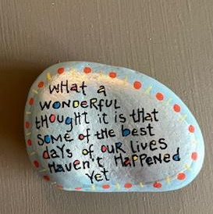
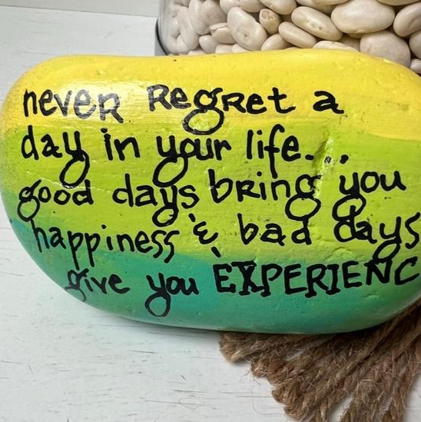
www.iamals.org/artistry-of-als-2025/
Katie has been painting these beautiful bits of inspiration for years. Each time she leaves one, she hopes someone who needs the message will find it and feel loved.

Slide 33
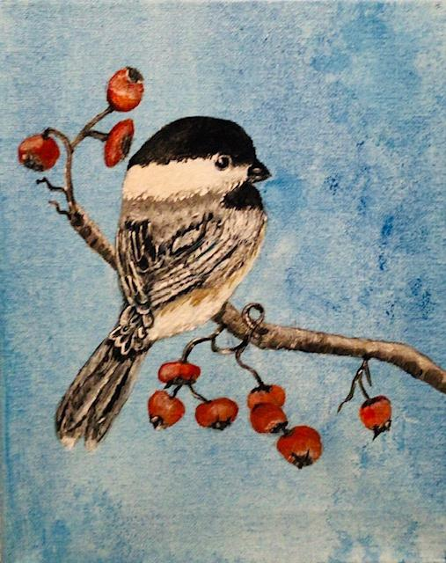
LOIS ISABEL
Lois taught herself to paint after retiring at 66. Her passions are gardening, hiking, photography, and caring for her young grandson.
www.iamals.org/artistry-of-als-2025/

Slide 34
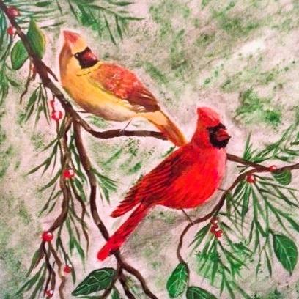
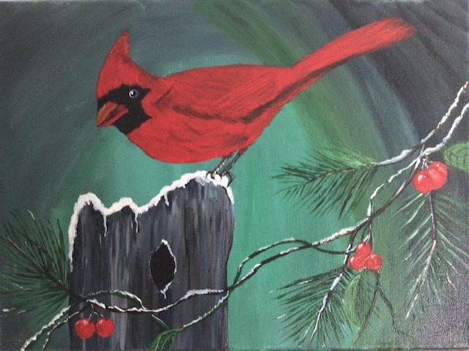
www.iamals.org/artistry-of-als-2025/

Slide 35
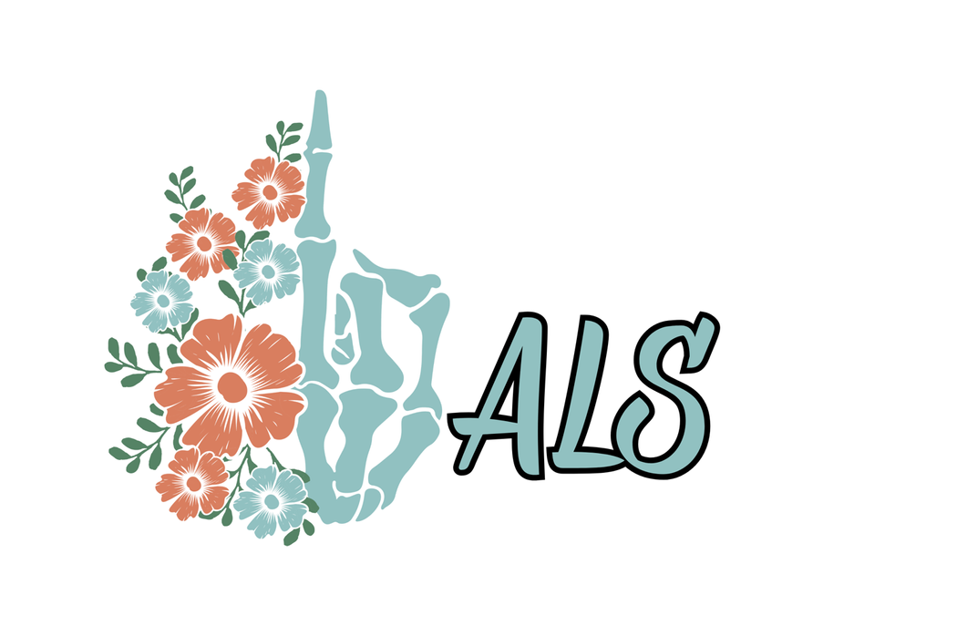
www.iamals.org/artistry-of-als-2025/
MARK COMBOT
Mark uses AI to generate these images of inspiration, and shakes his fist unapologetically at ALS .

Slide 36
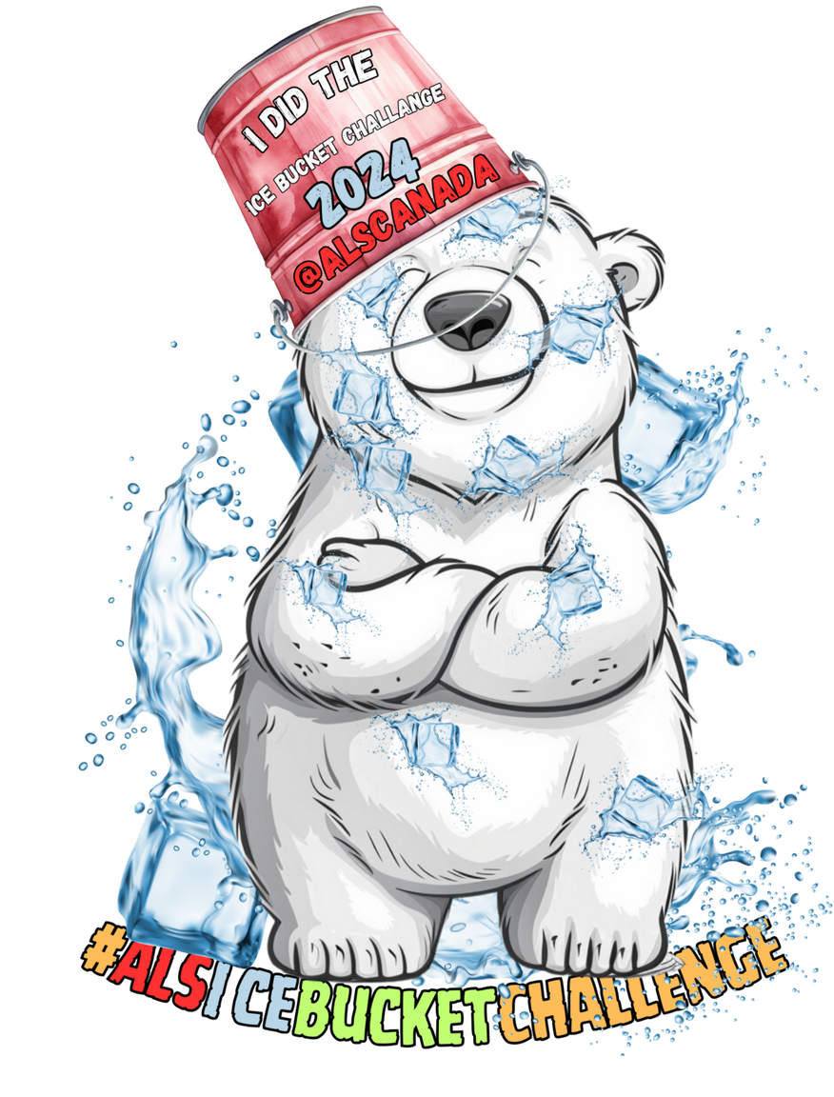
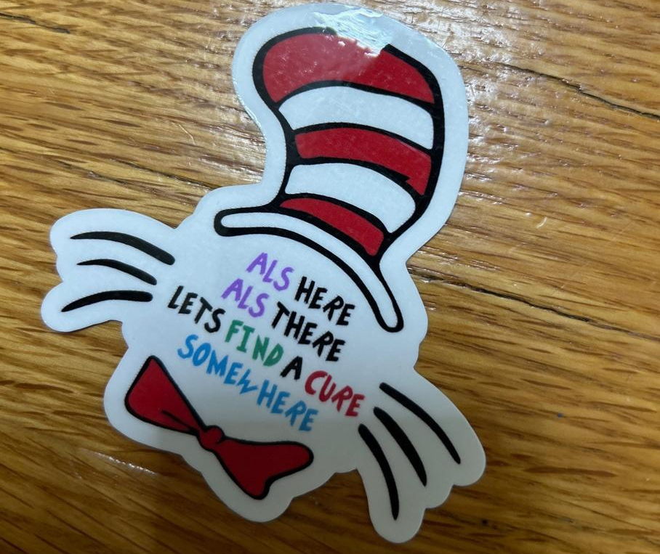
www.iamals.org/artistry-of-als-2025/

Slide 37
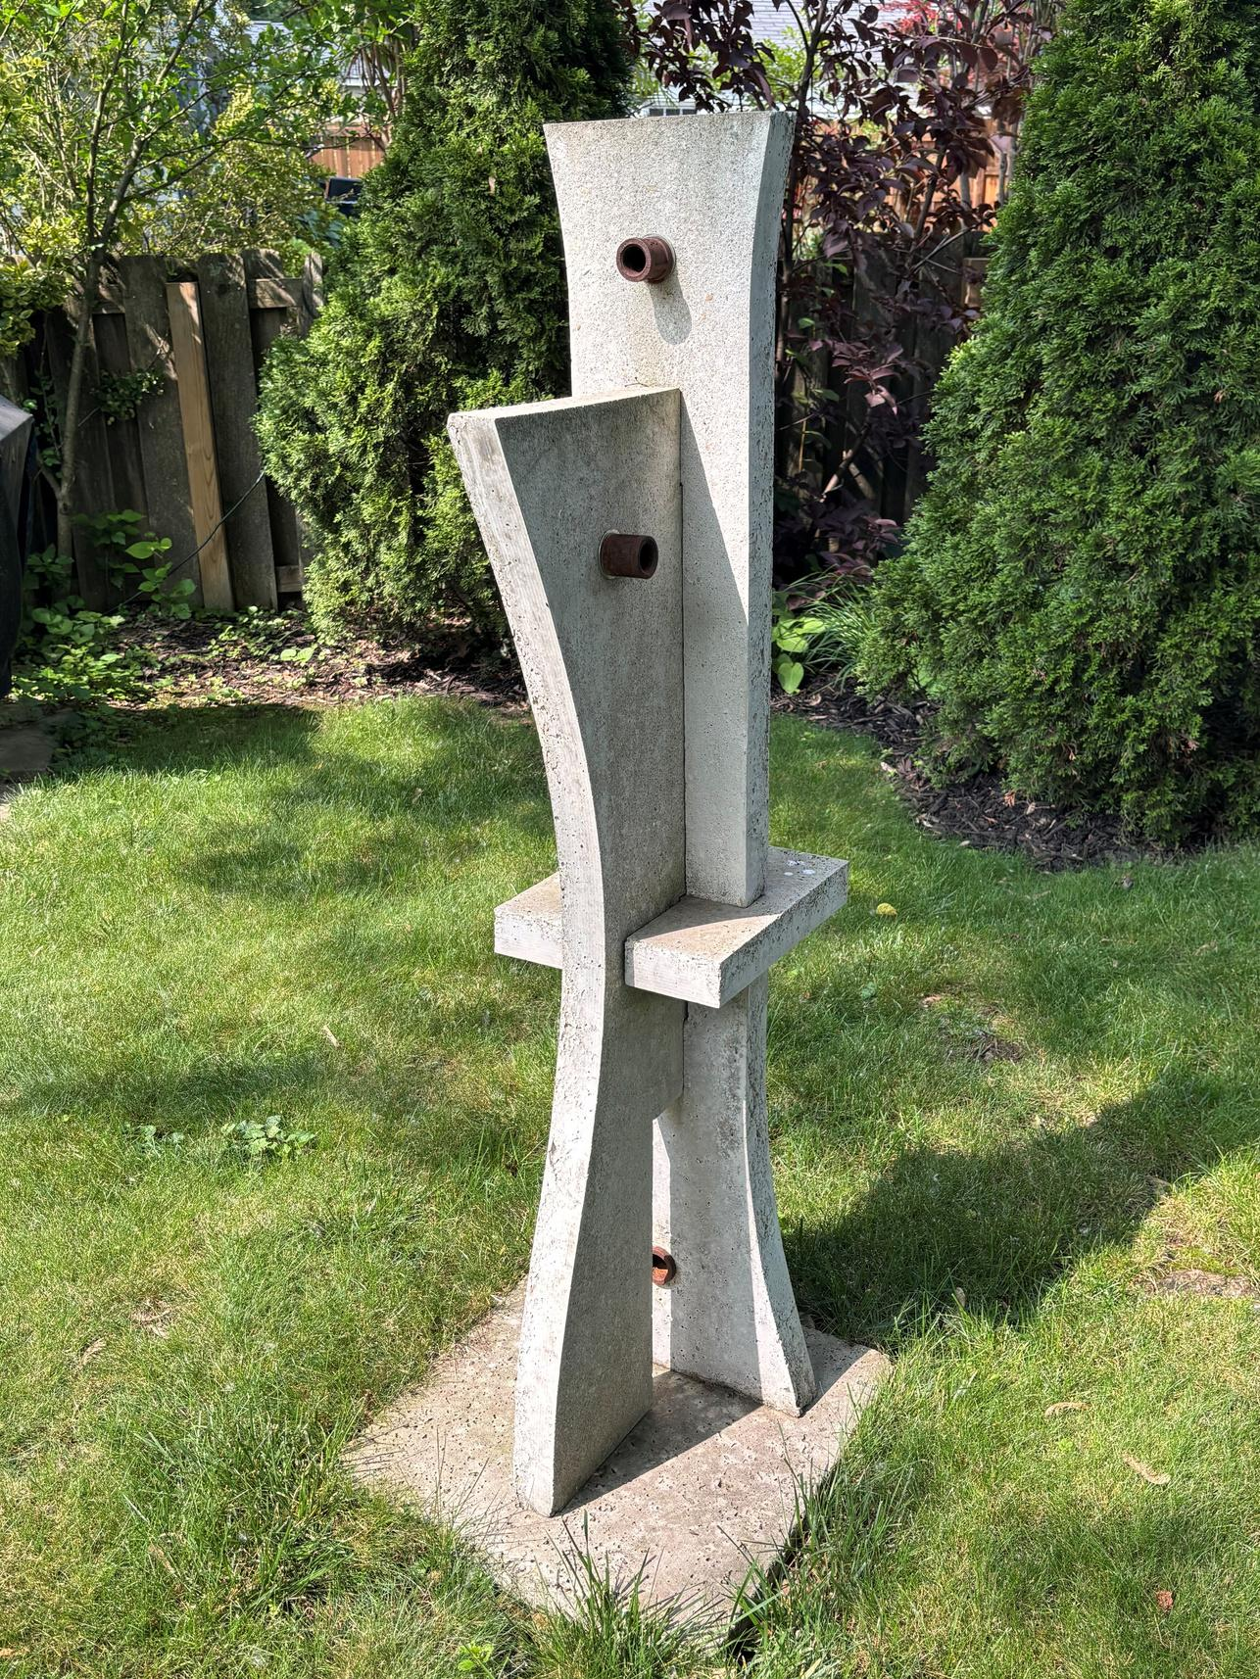
MARK TOURIS
@reallygreatsite
Mark has been an artist all his life, with a BFA from Columbus College of Art & Design and an MFA from the University of Montana, both in Sculpture
www.iamals.org/artistry-of-als-2025/

Slide 38
www.iamals.org/artistry-of-als-2025/
As a sculptor, Mark was creating large scale mixed media works that required a lot of physicality and strength to produce. He now gets pleasure from drawing portraits of his beautiful family.

Slide 39
MARY PORTER
Dauntless
Physician
Veteran
Athlete
This is Mary’s second time participating in the Artistry of ALS. Since her first showing, Mary has become a Gold Medalist in the 2025 Invictus Games, and is currently focusing on her fencing skills with the goal of competing in future events!!
www.iamals.org/artistry-of-als-2025/

Slide 40
www.iamals.org/artistry-of-als-2025/

Slide 41
www.iamals.org/artistry-of-als-2025/

Slide 42
www.iamals.org/artistry-of-als-2025/
MICHAEL ROBINSON
New Artist
Realist
Hopeful

Slide 43
www.iamals.org/artistry-of-als-2025/
Michael taught himself to draw after being diagnosed with ALS. His favorite medium is colored pencil on drafting paper.

Slide 44
www.iamals.org/artistry-of-als-2025/

Slide 45
RALPH HUA
www.iamals.org/artistry-of-als-2025/

Slide 46
www.iamals.org/artistry-of-als-2025/
Born in Wuxi, China, Ralph immigrated to the US as a young man, matriculating at Seattle University School of Law in 2006. An immigration lawyer and an avid photographer, he enjoyed capturing the beauty of national parks. After his diagnosis, Ralph loved to photograph the water from his home on Brainbridge Island, in Washington State.

Slide 47
www.iamals.org/artistry-of-als-2025/

Slide 48
RICK MARTINSON
The Ultimate Retriever
By Rick D. Martinson
Last fall I was bouncing nymphs off the bottom of my favorite section of the Deschutes, with the usual results - cold feet. Today though, I felt lucky...
www.iamals.org/artistry-of-als-2025/

Slide 49
The sun showed through the intermittent clouds, warming my exposed fingertips. It was one of those days when I was glad just to be out there, regardless of the outcome. I was exercising my soul, toning the disposition muscle, and working on my attitude. My usual companion, Casey, was along. I didn't want to have to scare the fish away myself, and Casey was so good at it. Casey is your typical Golden Retriever, dense undercoat to stay warm, bad hip, passion for the water, and an inner belief that she really is human.
Our prey today was the fat, elusive Deschutes Redside. I'm still learning to fly fish, so my technique is rough, but I really enjoy learning on the beautiful and productive Deschutes. There have been surveys done that estimate the resident trout population to be in the neighborhood of 2000 per linear mile. That's a lot of trout!
www.iamals.org/artistry-of-als-2025/

Slide 50
Well, I've found a really, nice little stretch of water - a deep pool just behind a whitewater riffle. Well oxygenated, deep for cover and cool water and just down river of a very productive rocky area just bulging with stones, caddis flies and other tasty little morsels. For the trout, that is. While I was working this stretch, Casey was upriver chasing her shadow, or some other imaginary friend; the dog has no foe.
I was just about ready to five up on the hole - you know, the proverbial last cast - when my weighted elk hair caddis begins moving in a direction opposite the current. Now, I'm no genius, but I know that can only mean one thing - trout! I might add, I knew this more from watching 'Fishing the West' than from catching trout in the past. Anyway, it had to be a trout on my line now, and I was determined to finesse it in, since I only had a 2X gut tethering him to me.
www.iamals.org/artistry-of-als-2025/

Slide 51
While trying to gain a little ground on this scarlet honey, I noticed Casey drifting down river towards me. This alarmed me some, but I didn't think she was in any danger; the water after the riffle was slow and she could swim ashore. The only problem was, she was coming, more or less, directly at my fish. To make things worse, just as Casey came through the riffle, the fish headed out and up the riffle, and the line caught Casey just under the snout! This almost immediately snapped the line at the tippet - or so I thought - and the line went limp.
I cussed Casey, but was glad to see her make her way to shore. I waded down to her and pulled her to me, only to notice the line snagged on her collar! I grabbed the line, and sure enough, the fish was still tethered. I spent the next five minutes or so gingerly taking up line and landing the fish. I considered it such a miracle to land the fish after all that, I released the beautiful 16-inch buck to swim and be caught again, in the traditional manner.
www.iamals.org/artistry-of-als-2025/

Slide 52
www.iamals.org/artistry-of-als-2025/

Slide 53
STEPH THOMPSON
www.iamals.org/artistry-of-als-2025/

Slide 54
Stephanie is a self-taught artist who has turned to alternative means to express herself and work through feelings about her diagnosis. Initially very angry, she now focuses on creating images of beloved pets for friends.
www.iamals.org/artistry-of-als-2025/

Slide 55
www.iamals.org/artistry-of-als-2025/
TROY FIELDS
This is Troy’s second time participating in the Artistry of ALS. He is the spirited co-chair of the I Am ALS Legislative Affairs Team, a devoted father and husband, and a great friend to all who meet him.

Slide 56
www.iamals.org/artistry-of-als-2025/
@reallygreatsite

Slide 57
Carol Van Alstine and Willie Jaeg make up this dynamic duo, comprised of a pure-voiced poet and a dulcimer wizard weave their voices and instruments into a rich, harmony-driven sound that is fresh and innovative. Their music is the soundtrack to this gallery. We are grateful for their gift.
You can learn more about their music at https://jubilantbridge.net/
www.iamals.org/artistry-of-als-2025/

Slide 58
ARTISTRY OF ALS
See interviews with the artists at www.iamals.org/artistry-of-als-2025/

